Slide 1



UNITED STATES – INDIA
EDUCATIONAL FOUNDATION (USIEF)
Promoting Mutual Understanding
Notes:
Speaker: Mr. Adam Grotsky

Slide 2



USIEF’s MANDATE
Meet the Team
Administer the
Fulbright-Nehru and other Fulbright fellowships for Indian and American students, lecturers, researchers and professionals
Provide educational advising services for Indian students interested in pursuing higher education in the U.S.
Serve as a resource for fostering linkages between higher education institutions in the U.S. and India
www.usief.org.in
Notes:
Speaker: Mr. Adam Grotsky

Slide 3
USIEF’s STRUCTURE
Meet the Team
Activities guided by a binational
Board of Directors
Program management and staff overseen by the Executive Director,
Adam J. Grotsky,
and
Deputy Director,
Megha Sunger
Headquarters in
New Delhi
with regional offices in Chennai, Kolkata, and Mumbai
www.usief.org.in
Notes:
Speaker: Mr. Adam Grotsky

Slide 4

THE FULBRIGHT PROGRAM: ESTABLISHED IN1946
Meet the Team
PROGRAM OBJECTIVES
Increase mutual understanding between the people of the United States and the people of other countries
Create a large academic and cultural network around the world
FULBRIGHT IN INDIA
Since 1950, USIEF has awarded over 21,000 Fulbright Fellowships to Indian and American citizens
For 2025-26, USIEF has awarded 78 Fulbright-Nehru and Fulbright-Kalam Fellowships to U.S. citizens
For 2025-26, USIEF has awarded 82 Fulbright-Nehru and Fulbright-Kalam Fellowships to Indian citizens
www.usief.org.in
Notes:
Speaker: Mr. Adam Grotsky

Slide 5
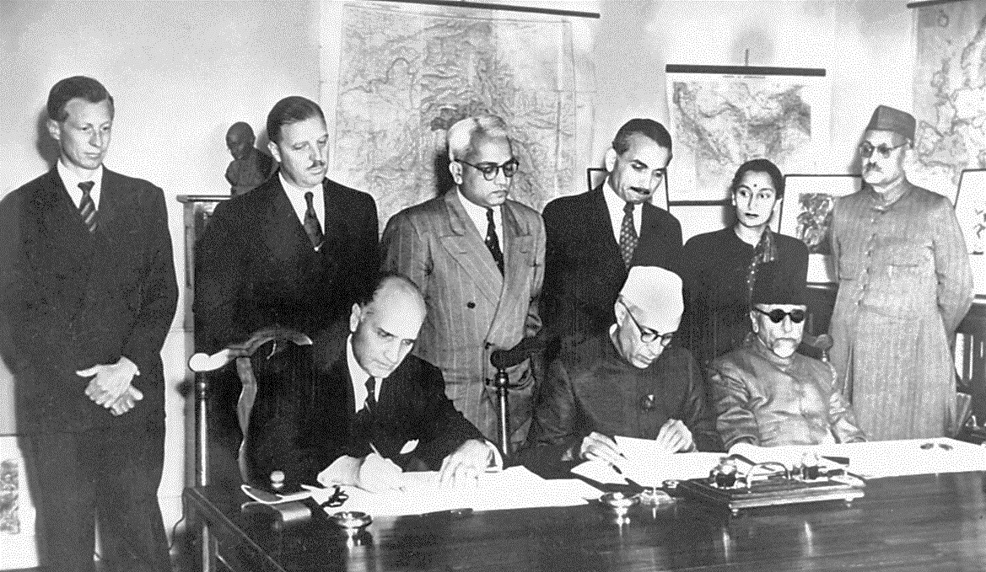
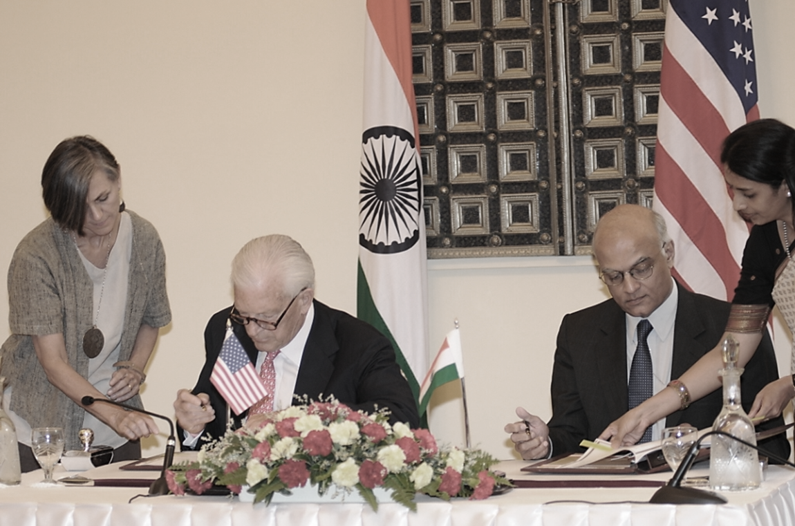

THE FULBRIGHT PROGRAM IN INDIA
Meet the Team
February 2, 1950
July 4, 2008
Prime Minister Jawaharlal Nehru and U.S. Ambassador to India Loy Henderson sign the Fulbright Agreement for India
Foreign Secretary Shiv Shankar Menon and U.S. Ambassador to India David C. Mulford declaring both India and U.S. equal partners
www.usief.org.in
Notes:
Speaker: Mr. Adam Grotsky

Slide 6

Certificate of Affiliation
All Fulbrighters will be affiliated with ONE primary affiliating institution. USIEF will secure your Certificate of Affiliation (CoA) from your proposed host institution.
All Fulbrighters must be affiliated with institutions/organizations of higher education approved and listed on the website of the Ministry of Education, Government of India, including institutions accredited by AICTE, UGC and other Apex Level Bodies of the Ministry or medical institutions accredited by the National Medical Commission.
This means that Fulbrighters cannot be affiliated with non-government organizations (NGOs), think-tanks, research organizations or other institutions that are not recognized by these regulatory bodies.
This CoA is used to apply for your Student Visa/ Project Clearance.
Once you receive your CoA, please be in touch with your academic host in India to plan your teaching/ research.
www.usief.org.in
Notes:
Speaker: Ms. Priyanjana Ghosh

Slide 7
Medical Clearance
Medical clearance is a prerequisite for starting your grant.
This process is managed by our partner IIE in the U.S. IIE will send a detailed email regarding the medical clearance process.
The Medical History and Examination Form should be completed and submitted within 2-6 months of the grant start date.
Questions related to medical clearance can be addressed to FulbrightScholarAdvisingSCA@iie.org.
www.usief.org.in
Notes:
Speaker: Ms. Priyanjana Ghosh

Slide 8
Grant Award Letter
USIEF issues the Fulbright Grant Authorization document (Non-IIE grant doc).
USIEF will also provide a digital copy of the Visa / Project Clearance Support Letter 6-8 weeks prior to the start of your grant.
Please sign, scan and return a copy each to IIE and USIEF.
www.usief.org.in
Notes:
Speaker: Ms. Priyanjana Ghosh

Slide 9
Student Visa (S-5) or Project Clearance
All Scholars must apply for Student Visa
- For grants less than 5 months (including flex grants), scholars must apply for a six-month Multiple Entry Student Visa (visa less than 180 days).
- For grants that are between 6 to 12 months in length, scholars must apply for a one-year Multiple Entry Student Visa.
Overseas Citizens of India (OCI) card holders require a Project Clearance from the online OCI services portal: https://ociservices.gov.in/welcome
Official dependents –Student Visa or OCI card holders.
Please send USIEF a copy of your visa/project clearance as soon as you receive it.
www.usief.org.in
Notes:
Speaker: Ms. Priyanjana Ghosh

Slide 10
Travel Arrangements
USIEF arranges round-trip air tickets for all Fulbright-Nehru and Fulbright-Kalam grantees. For Flex grantees, USIEF will provide two or three round trip air tickets for the grantee only.
Travel must comply with the ‘Fly America Act’.
Fulbright-Nehru and Fulbright-Kalam grantees can also use Air India.
Tickets will be issued after issuance of Student Visa/ Project Clearance as well as Medical Clearance.
www.usief.org.in
Notes:
Speaker: Ms. Priyanjana Ghosh

Slide 11
Grant Dates
All U.S. Fulbright-Nehru and Fulbright-Kalam scholars are required to enter grant status anytime between August 25, 2025, to May 31, 2026.
All Flex scholars are required to enter grant status anytime from August 25, 2025, to May 31, 2026, for not less than one month and complete the final grant phase by August 31, 2027.
All U.S. Fulbright scholars to India are required to meet virtually (or in person if you will be in a city with a USIEF office, i.e., Delhi, Chennai, Kolkata and Mumbai) with a USIEF official within 24 hours of their arrival in India.
www.usief.org.in
Notes:
Speaker: Ms. Priyanjana Ghosh

Slide 12
Allowances
Allowances are paid in dollars and are wire transferred to your designated U.S. bank account.
USIEF absorbs wire transfer charges up to $15 upon submission of bank statement.
First transfer is made one week prior to your arrival.
Subsequently, USIEF advances funds for two months.
USIEF will provide a Schedule of Payment to scholars before arrival in India.
www.usief.org.in
Notes:
Speaker: Ms. Priyanjana Ghosh

Slide 13
Dependents
Distinguished Scholar, Academic and Professional Excellence and Fulbright-Kalam Scholars:
Travel allowance - up to two dependents
Dependent allowance - up to three dependents. Dependents must accompany the grantee for at least 80% of the grant period
Tuition fees to be reimbursed up to $5,000 per child or $10,000 per family for accompanying dependent children in grades K-12 on reimbursement basis
Flex Scholars:
Dependent allowance - up to two dependents. Dependents must accompany the grantee for at least 80% of the entire grant period
www.usief.org.in
Notes:
Speaker: Ms. Priyanjana Ghosh

Slide 14
Housing
Initial 7 days accommodation at the city of affiliation is provided and paid by USIEF upon arrival.
Flex scholars will receive total of seven nights initial accommodation (room only) as arranged by USIEF that can be availed during any of the phases of the grant.
In cities where USIEF has offices, housing assistance is provided through realtors/agents.
In other cities, USIEF encourages host institutions to provide support for identifying housing.
USIEF shall reimburse brokerage fee up to $600 (maximum) one time only, upon submission of brokerage receipt.
Certain cities may require 4 to 6 months rent in advance by homeowners as security deposit.
www.usief.org.in
Notes:
Speaker: Ms. Priyanjana Ghosh

Slide 15
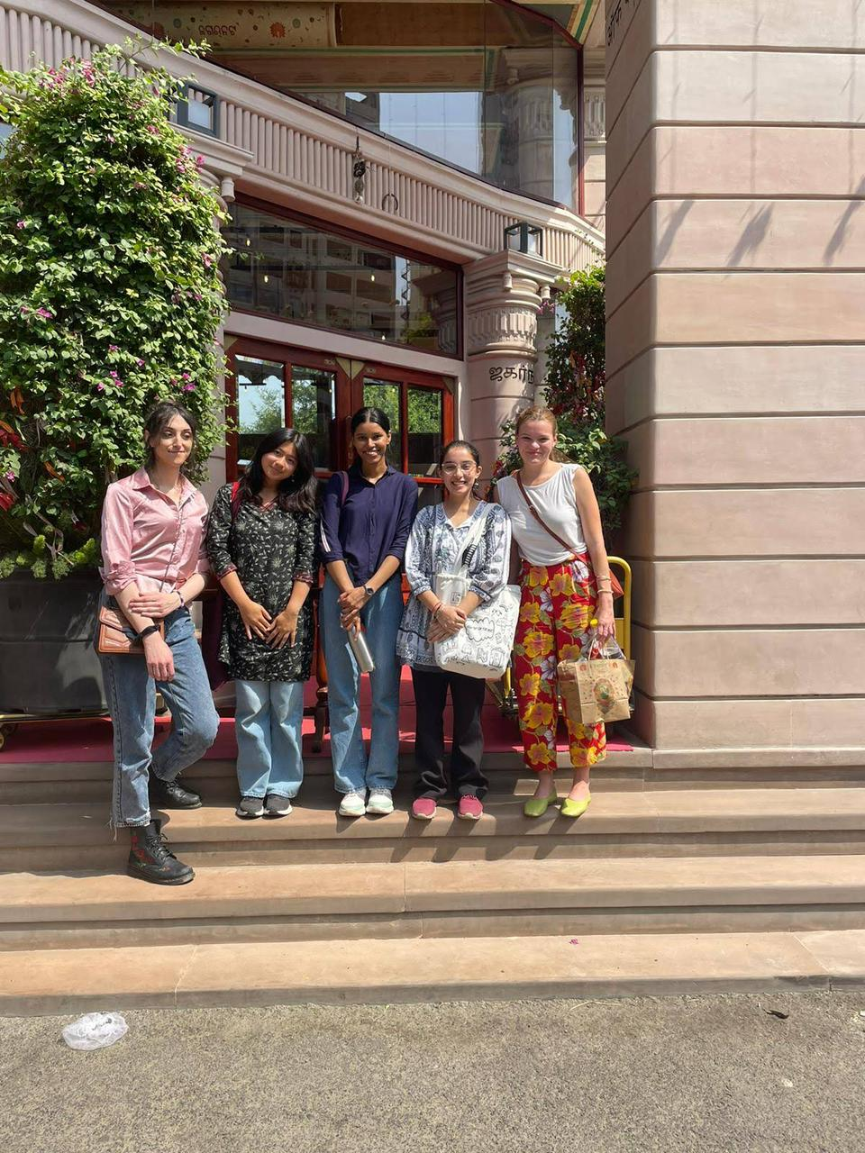
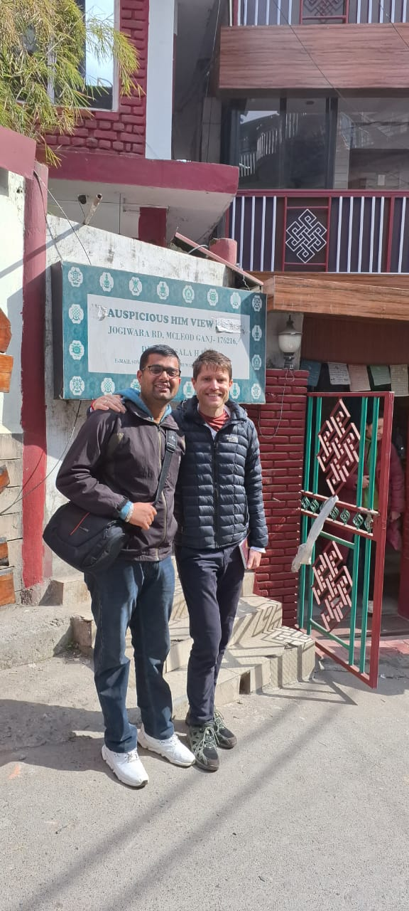
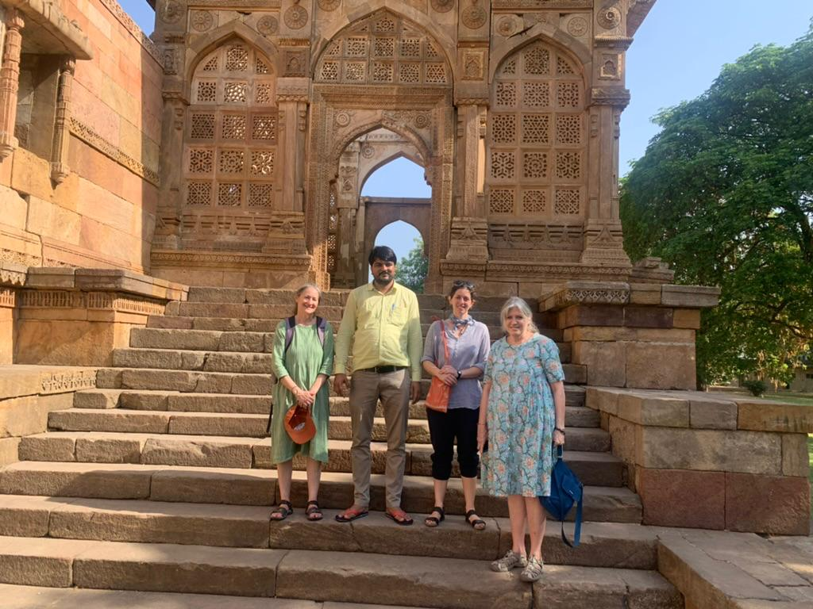
Facilitation
USIEF provides the support of a facilitator at your place of affiliation to ease your settling in process.
The facilitator will assist you in obtaining cell phone & internet connection, apprising about the local neighborhood and travel within the affiliating city.
www.usief.org.in
Notes:
Speaker: Ms. Priyanjana Ghosh

Slide 16
Registration in India
All Student Visa holders (for visas valid for more than 180 days) MUST register with GOI’s Foreigners Regional Registration Office (FRRO)/ Foreigners Registration Office (FRO) at your place of affiliation within 14 days of arrival in India.
For registration, grantees must show proof of accommodation at city of affiliation for the entire duration of grant period.
Registration process may vary from place to place and may take time. Grantees should plan their grant-related travel in India only after the completion of the registration process. In some cases, this could take up to two weeks.
Some FRROs require your registration to be channeled through your affiliating institute.
Visa extension/residency extension also need to be processed at the place of your FRRO registration 60 days before the expiry of your current residential permit.
USIEF will guide you regarding the FRRO process upon your arrival in India.
www.usief.org.in
Notes:
Speaker: Ms. Priyanjana Ghosh

Slide 17
Safety & Security
U.S. Fulbrighters should get an Indian phone connection immediately upon arrival in India. Please provide your Indian phone number to USIEF as soon as it gets activated.
USIEF will activate a phone tree at the time of an emergency, including natural disaster, civil unrest, terrorist attack, etc.
Fulbright grantees should familiarize themselves with the State Department’s information on India: https://travel.state.gov/content/travel/en.html
Fulbright grantees are required, upon arrival in India, to register their names with the Consular Section at the U.S. Embassy through the Smart Traveler Enrolment Program (STEP): https://step.state.gov/step/
www.usief.org.in
Notes:
Speaker: Ms. Priyanjana Ghosh

Slide 18
Health
For advice on immunizations, please contact your doctor or travel clinic. The Center for Disease Control and Prevention website (www.cdc.gov) has comprehensive health information for travelers.
Please make sure to familiarize yourself with India’s mosquito borne and water borne diseases, air pollution challenges, et al.
The U.S. Department of State has contracted with Seven Corners, a third-party administrator, to offer Accident and Sickness Program for Exchanges (ASPE), a limited healthcare benefit to help pay covered medical expenses. This benefit is valid during your grant period in India only. This is a health benefit plan and not comprehensive health insurance; it is subject to specific limitations. Fulbright recipients are responsible for providing their dependents with insurance.
In case of any medical emergency, please contact USIEF immediately.
www.usief.org.in
Notes:
Speaker: Ms. Priyanjana Ghosh

Slide 19
Travel & Leave Policy
Fulbright grants require a full-time commitment, therefore travel (domestic and international) which is unrelated to the grant purpose is to be kept to a minimum.
Grantees must inform USIEF by email when they travel outside their city of affiliation.
Any travel outside of India without prior permission of USIEF will result in immediate revocation of the Fulbright grant.
Jammu and Kashmir: Fulbright students and scholars in India are prohibited from traveling to Jammu & Kashmir. Any travel to this region will result in the immediate revocation of the Fulbright grant.
www.usief.org.in
Notes:
Speaker: Ms. Priyanjana Ghosh

Slide 20
Travel & Leave Policy continued…
All Fulbright-Nehru and Fulbright-Kalam grantees are eligible for 14 days of out-of-country travel with prior permission at least 2 weeks in advance from USIEF. Out-of-country travel includes weekends and holidays. APE Flex Scholars are eligible for a total of 7 days of out-of-country travel across all grant phases with prior permission from USIEF.
Travel expense: Grantee’s responsibility.
Stipend is continued but ASPE is suspended.
International travel is not permitted towards the end of the grant.
www.usief.org.in
Notes:
Speaker: Ms. Priyanjana Ghosh

Slide 21
South and Central Asia Regional Travel Program (SCA-RTP)
Provides travel grants to Fulbright Scholars to spend a period of three to fourteen days in another South and Central Asian country during their grant period to participate in professional activities.
Offers local academic institutions, U.S. Embassies and Consulates, and Fulbright Commissions in South and Central Asia the opportunity to benefit from the academic and professional expertise of U.S. Fulbright Scholars currently in the region.
The SCA Regional Travel Grant is counted towards 14 days of international travel provided to Fulbright scholars.
Flex Grantees are now eligible for SCA Regional Travel Grant. However, there is a maximum of seven days allowed.
USIEF will announce the SCA-RTP award in September 2025.
www.usief.org.in
Notes:
Speaker: Ms. Priyanjana Ghosh

Slide 22
Taxes
No taxes are withheld from Fulbright grants.
USIEF cannot provide advice on filing taxes.
Grantees should refer to the Grant Authorization and Schedule of Payment when doing taxes.
Also, please refer to the section on taxes in the Fulbright to India Guide.
www.usief.org.in
Notes:
Speaker: Ms. Priyanjana Ghosh

Slide 23
Reporting Requirements: Distinguished Scholar, Academic and Professional Excellence and Fulbright-Kalam Scholars
USIEF
- Mid-term report (for grants more than 6 months and flex grants)
- Final report
www.usief.org.in
Notes:
Speaker: Ms. Priyanjana Ghosh

Slide 24
Google Group and Social Media
Group designed to connect all Fulbrighters to India to share information and resources. Group will be formed after the VPDO: fulbrighttoindia@googlegroups.com.
You are encouraged to share photos and videos about your Fulbright experience for USIEF social media postings.
Please tag USIEF and Fulbright on X, Instagram, LinkedIn and Facebook whenever posting about your work.
www.usief.org.in
Notes:
Speaker: Ms. Priyanjana Ghosh

Slide 25
Who Is Your Contact?
Grant related: USIEF Delhi
Distinguished Scholar, Academic and Professional Excellence and Fulbright-Kalam Scholars: Pavitra Soram, Anupam Anand and Priyanjana Ghosh
Local issues such as housing, health concerns, etc., contact USIEF regional office:
- Chennai: Maya Sundararajan, Shinu Shoba
- Kolkata: Jhulan Ghose
- Mumbai: Ryan Pereira, Suranjana Das
www.usief.org.in
Notes:
Speaker: Ms. Priyanjana Ghosh

Slide 26
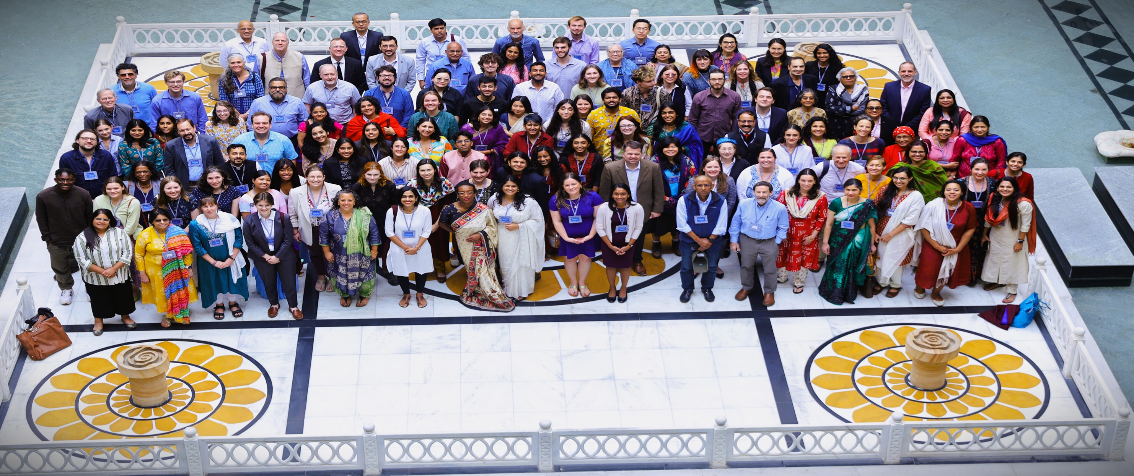
www.usief.org.in
Notes:
Speaker: Ms. Priyanjana Ghosh

Slide 27

QUESTIONS
Notes:
Speaker: Mr. Adam Grotsky

